Slide 1
Print PIMS label user manual
2015-2-5
MIS – ling.xie
115/11/07

Slide 2
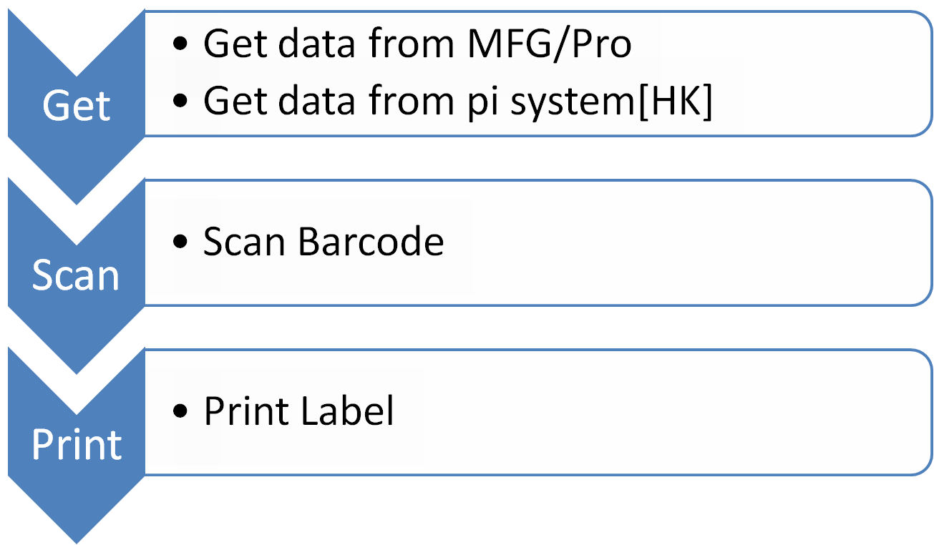
Print PIMS label
115/11/07

Slide 3
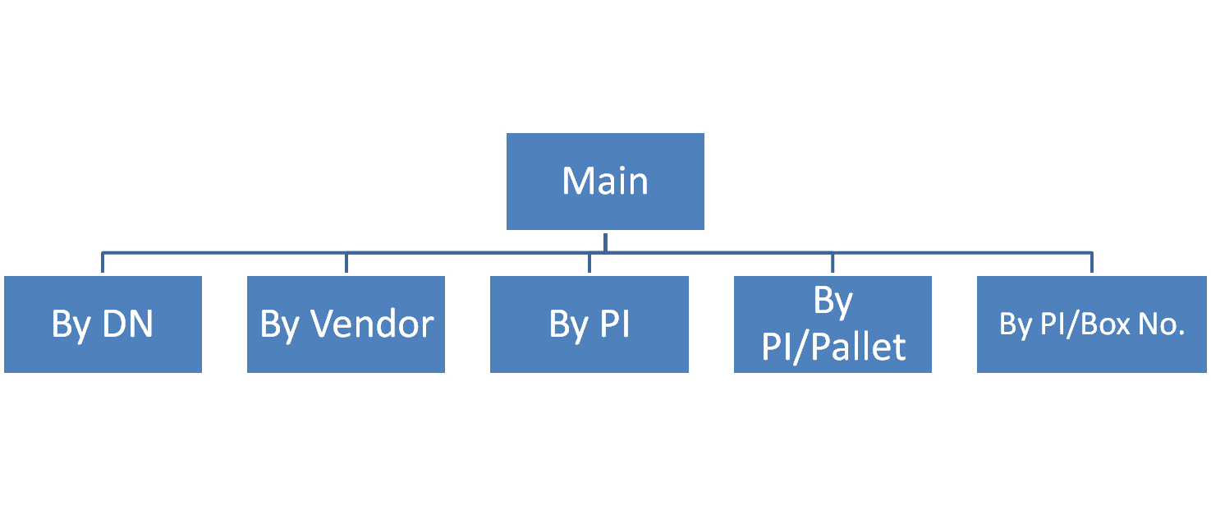
Print PIMS label
115/11/07

Slide 4
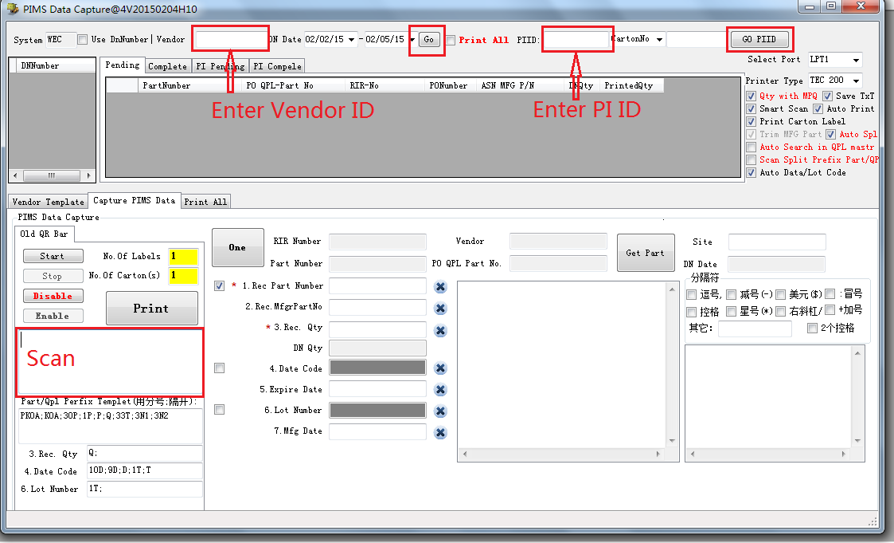
Print PIMS label Soft
115/11/07

Slide 5
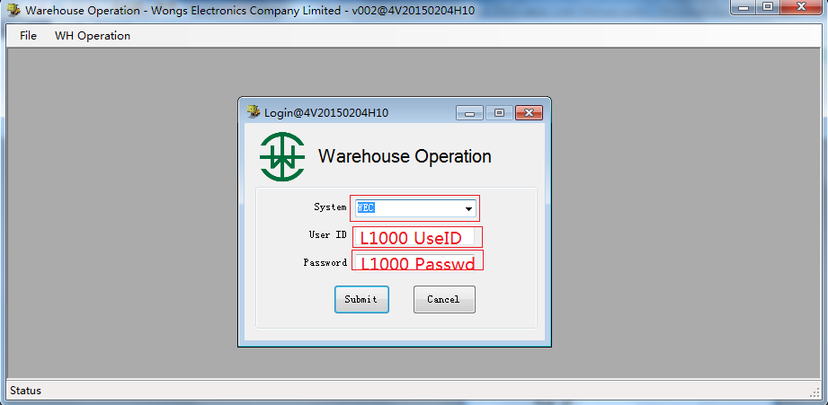
Log On
115/11/07

Slide 6
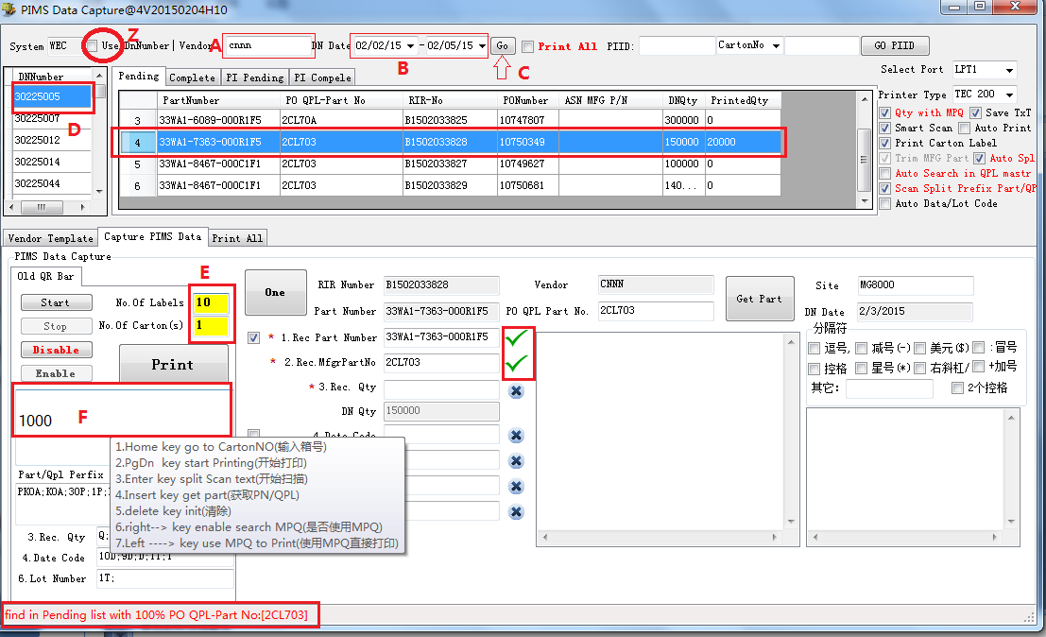
Scan By Vendor/Dn
A: Enter Vendor ID B:Select the right Date Time C: click go
D: Select a Dn No E:Enter Num of Labels F: Scan Barcode
115/11/07

Slide 7
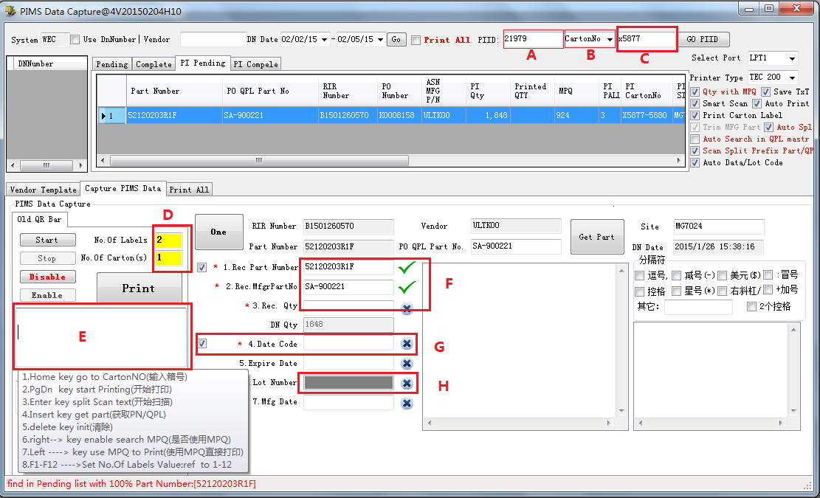
Scan PI/Pallet/CartonNO
A: Enter PI ID B:Select the right Item (Pallet/CartonNo)
C: if Carton No then Scan Box No D:Enter Num of Labels E: Scan Barcode
115/11/07

Slide 8
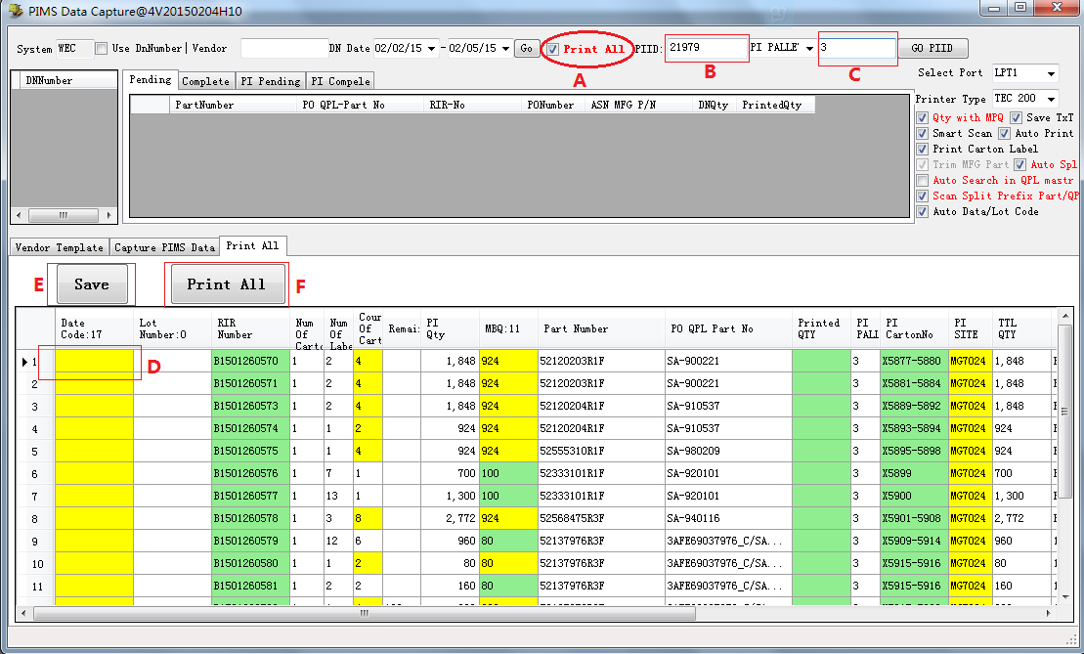
Print All for PI
A:Check Print All B: Enter PI ID C: if Carton No then Scan Box No D:Enter Date Code /Lot Num /MPQ E: Save F:Print All
115/11/07

Slide 9
Function Key
1.Home key go to Carton NO(输入箱号)
2.PgDn key start Printing(开始打印)
3.Enter key split Scan text(开始扫描)
4.Insert key get part(获取PN/QPL)
5.delete key init(清除)
6.right----> key enable search MPQ(是否使用MPQ)
7.Left ----> key use MPQ to Print(使用MPQ直接打印)
8.F1-F12 ---->Set No.Of Labels Value: to 1-12
115/11/07

Slide 10
--END--
115/11/07

